Slide 1
Convolutional Coding
Recursive / Systematic
Non-recursive / Non-systematic

Slide 2
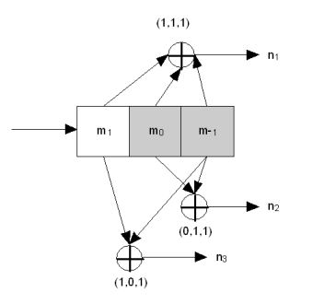
Non-recursive, Non-systematic
constraint length?
rate?
why “non-recursive”?
why “non-systematic”?

Slide 3
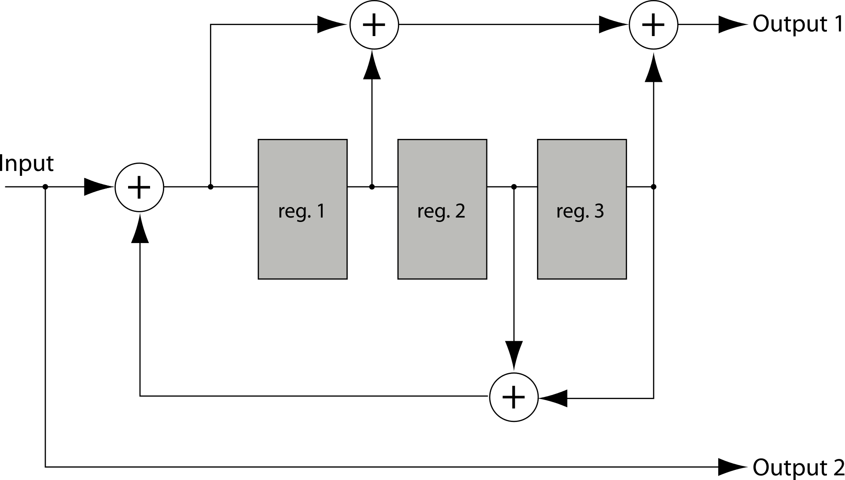
Recursive, Systematic
constraint length?
rate?
why “non-recursive”?
why “non-systematic”?

Slide 4
Which to Use?
Viterbi decoder obviously has to know rate, constraint length, recursiveness, and tap choices of encoder.
Recursive favored in turbo codes (beyond the scope of this class – take WES269 or ECE260C if interested ☺ ).

Slide 5
Relevance to Term Project
Term project does not necessarily use the Homework 7 encoder design. I give you the desired state transitions and outputs and ask you to figure out the encoder’s architecture. I also provide a test bench to let you ensure you have the correct solution for the encoder.

